Slide 1
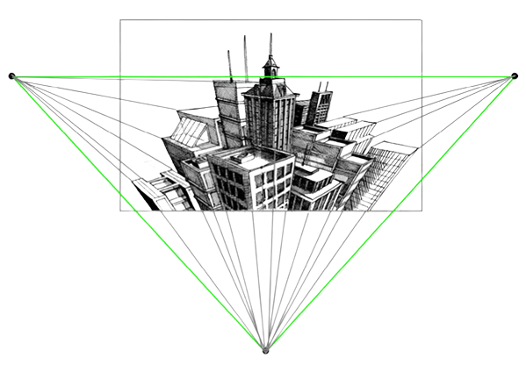
Perspective Projection/ Drawing
Prepared by:
Er. Bibek Magar
BE in Automobile Engineering
IOE, Thapathali Campus
bibek.magar@thc.tu.edu.np

Slide 2

Have you even wondered why we always drew sceneries in this particular fashion???
We were trying to imitate what we actually see with our eyes or in photographs
So objects farther are drawn smaller than the objects which are nearer to the observer.
Hence, in this chapter we are going to take a glance about drawing photograph like sketches using the theory of Perspective Projection.

Slide 3
Introduction
A perspective projection or view is a drawing of any object as it appears to the human eye. It is similar to a photograph of an object. As it is similar to what a human eye sees, it is extensively used in civil and architectural engineering.
The basic difference between an orthographic projection and a perspective projection is the assumption about the position of the observer with respect to the plane of projection.
For an orthographic projection, the observer is assumed to be at infinity and in front of the plane of projection so that projectors are perpendicular to the plane of projection.
For perspective projections, the observer is assumed to be at a limited distance from the plane of projection so that the lines of sight, which join the eye of the observer to the object points, remain neither parallel to each other nor inclined at the same angle to the plane of projection. In a perspective projection, these lines of sight are usually referred to as visual rays. The points at which these visual rays meet the picture plane (PP) are the perspective projections of object points.

Slide 4

Some terminologies used in perspective projection:
Picture Plane (PP)
Auxiliary Ground Plane (AGP)
Axis of Vision/ Perpendicular Axis
Centre of Vision
Horizon Plane (HP)
Horizon Line (HL)
Station Point (SP)
Ground Line (GL)
Ground Plane (GP)

Slide 5
Ground Plane (GP): This is a horizontal reference plane on which the object is assumed to be located.
Picture Plane (PP): Just like the case of orthographic projections, a picture plane, that is, a plane of projection, is required, to obtain the perspective projection. Usually, a vertical plane, located between the observer (i.e., the station point) and the object, is selected for the perspective projection.
Ground Line (GL): The line of intersection of the horizontal ground plane (GP) and the picture plane (PP) is known as the ground line (GL).
Station Point (SP): The position or the point from where the object is assumed to have been viewed by the observer’s eye is called the station point (SP).
Horizon Plane (HP): A horizontal plane passing through the station point and parallel to the ground plane (GP) is known as the horizon plane (HP).
Horizon Line (HL): The line of intersection of the horizon plane (HP) and the vertical picture plane (PP) is known as the horizon line (HL).
Axis of Vision (AV): The line passing through the station point and perpendicular to the picture plane (PP) is known as the axis of vision (AV).
Auxiliary Ground Plane (AGP): A horizontal reference plane, above the level of the station point, which is used to project the top view of the object while drawing a perspective view, is known as the auxiliary ground plane (AGP).

Slide 6
Centre of Vision (CV): The point at which the axis of vision line penetrates the picture plane is known as the centre of vision (CV). It may be noted that the centre of vision will be located on the horizon plane.
Central Plane (CP): A vertical plane passing through the station point, and perpendicular to the picture plane as well as the ground plane and the horizon plane is known as the central plane (CP).
Visual Rays (VR): The lines of sight joining the observer’s eye at the station point to various points on the object are known as visual rays.

Slide 10
Vanishing Point
Vanishing Points: These are imaginary points infinite distance away from the station point. In practice, the point at which the visual ray from the eye to that infinitely distant vanishing point pierces the picture plane is referred to as the vanishing point.
b
b
b
a
a
a
a1
b1
PP
a1
b1
VP
HL
VP
SP
Therefore, the vanishing point for any horizontal line is found by drawing a line parallel to the top view of that line from the top view of the station point. The point at which this line intersects the top view of the picture plane is then projected on the horizon line. This point on the horizon line is the front-view position of the vanishing point.
Lines which are parallel to the picture plane will have no vanishing points. They vanish at infinity.

Slide 11




Types of Perspective
Parallel (One Point) Perspective
Angular (Two Point) Perspective
Oblique (Three Point) Perspective

Slide 12
Parallel (One Point) Perspective: When an object has its one or more faces parallel to the picture plane, its perspective is called parallel perspective also called one point perspective as the edges converge to a single vanishing point of the parallel faces.
Angular perspective or two point perspective: When an object has its two faces inclined to the picture plane, its perspective is called angular perspective also called two point perspective as the edges of the object converge to two vanishing points.
Oblique perspective or three point perspective: When an object has its three faces inclined to the picture plane, its perspective is called oblique perspective also called three point perspective as edges of the object converge to three vanishing points.

Slide 13
IMPORTANT POINTS ABOUT PERSPECTIVE PROJECTIONS
A surface touching the PP has its true shape and size in the perspective view.
Perspective views of lines touching the PP are of their true lengths and true inclinations.
Perspective views of vertical lines are vertical lines.
Perspective views of horizontal lines, parallel to each other and inclined to the PP, converge into a single point, which is the front view of the vanishing point.
Perspective views of lines parallel to the PP are parallel to the original lines.
If the object is behind the PP, the size of its perspective view will be reduced in size compared to the object. Also, the greater the distance from the PP, the smaller the perspective.
For an object of nearly equal length, the width and height the station point should be selected in such a way that the visual rays through the outermost boundaries of the object make a 30° angle between them. If the object is small, the station point should be selected such that a good view of the front side as well as the top of the object is obtained.

Slide 14
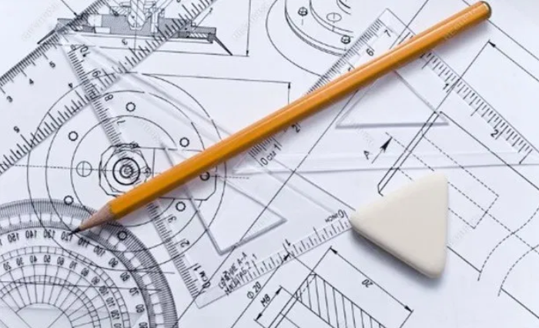
Solved Examples:

Slide 15
Q1) Draw perspective view of a 40*50*60 box. The station point is 50mm away from the picture plane and 80mm high from the ground plane. One of the smaller face is in contact with the picture plane and the station point is located right in front and in line with the axis of the box.
PP
50
SP
VP
HL
80
GL

Slide 16
Q2) A square prism of side base 30 mm and height 50 mm rests with it base on the ground and one of the rectangular faces inclined at 30⁰ to the picture plane. The nearest vertical edges touches the PP. The station point is 45 mm in front of the PP, 60 mm above the ground an opposite to the nearest vertical edge that touches the PP. Draw the perspective view of the prism.
30°
VP1
VP2
PP
45.0000
VP1
SP
VP2
HL
60.0000
GL

Slide 17
Q3) A model of steps has 3 steps of 15 mm tread and rise 10 mm. The steps measure 50 mm wide. The vertical edge of bottom steps, which is nearer to the picture plane, is 25 mm behind PP and the width of steps recede to the left at an angle of 30⁰ to PP. The station point is 100 mm in front of PP and 60 mm above the ground plane and 30 mm to the right of the vertical edge, which is nearest to PP. Draw the perspective view of the model.
45
15
15
50
30
10
10

Slide 18
X
X
30°
25.0000
VP2
VP1
PP
100.0000
SP
VP1
VP2
HL
60.0000
GL

Slide 19
Q4) A hexagonal prism, side of base 25 mm and height 50 mm with its base on the ground plane such that one of its rectangular faces is inclined at 30⁰ to the picture plane and the vertical edge nearer to PP is 15 mm behind it. The station point is 45 mm in front of the picture plane. 70 mm above the ground plane and lies in a central plane, which is 15 mm left to the vertical edge nearer to the picture plane. Draw the perspective projection of the prism.
30°
VP
PP
15
45
SP
VP
HL
70
GL

Slide 20
Alternative Solution:
PP
HL
GL

Slide 21
Alternative Solution:
PP
HL
GL

Slide 22
Q5) Draw the perspective drawing of a hexagonal pyramid, side of base 25 mm and axis 65 mm, when its base is on the ground and a side of its base parallel to the picture plane. The axis of the pyramid is 30 mm within the picture plane and 10 mm to the right of the eye. The eye is 80 mm from the picture plane and 60 mm from the ground.
30.0000
PP
80.0000
HL
60.0000
GL

Slide 23
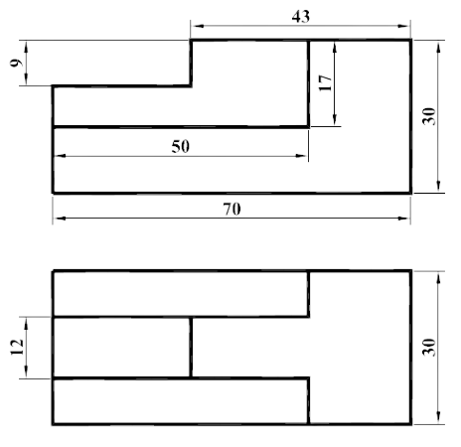
Q6) Draw the Parallel perspective projection from the given orthographic views.

Slide 24
PP
35
SP
VP
HL
60
GL

Slide 25
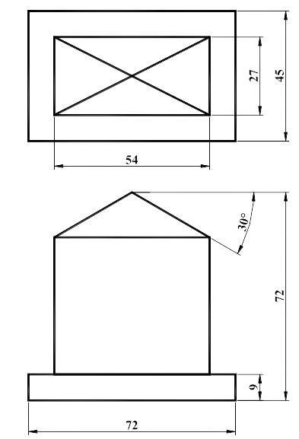
Q7) Draw the Angular perspective projection from the given orthographic views.

Slide 26
30°
VP1
VP2
PP
60
VP1
SP
VP2
HL
100
GL

Slide 27
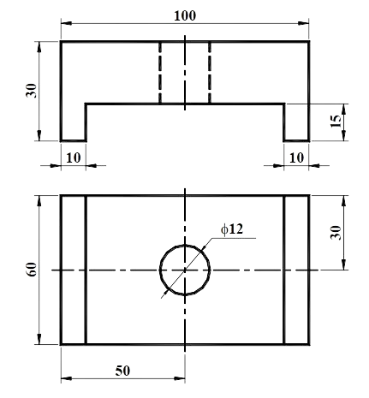
Q8) Draw the Parallel perspective projection from the given orthographic views.

Slide 28
VP
PP
SP
VP
HL
GL

Slide 29
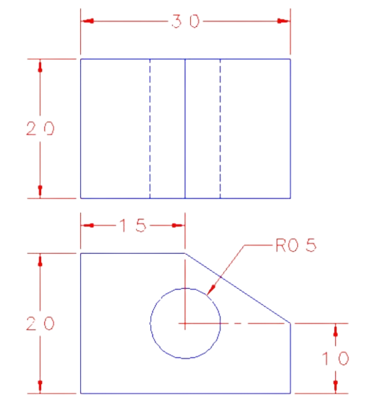
Q9) Draw the Angular perspective projection from the given orthographic views.

Slide 30
VP1
VP2
PP
VP1
SP
VP2
HL
GL

Slide 31
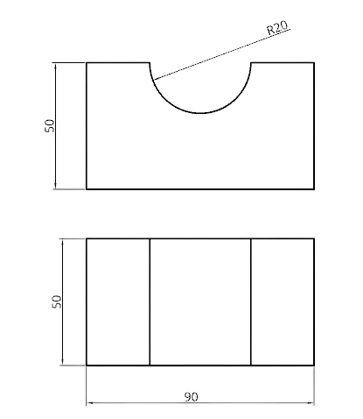
Q10) Draw the Angular perspective projection from the given orthographic views.

Slide 32
VP1
VP2
PP
VP1
SP
VP2
HL
GL

Slide 33
Q11) Draw the perspective view of a tetrahedron of 30mm edge when resting on ground plane on one of its faces with one of the resting edges parallel to the picture plane. The vertical axis of the tetrahedron is between this parallel edge and the picture plane, and 30 mm behind it. The station point is 45 mm in front of the picture plane, 50 mm to the left of the axis and 40 mm above the ground.
VP
PP
SP
VP
HL
R30
GL

Slide 34
